Slide 1


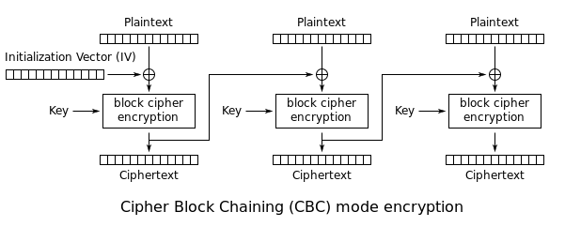
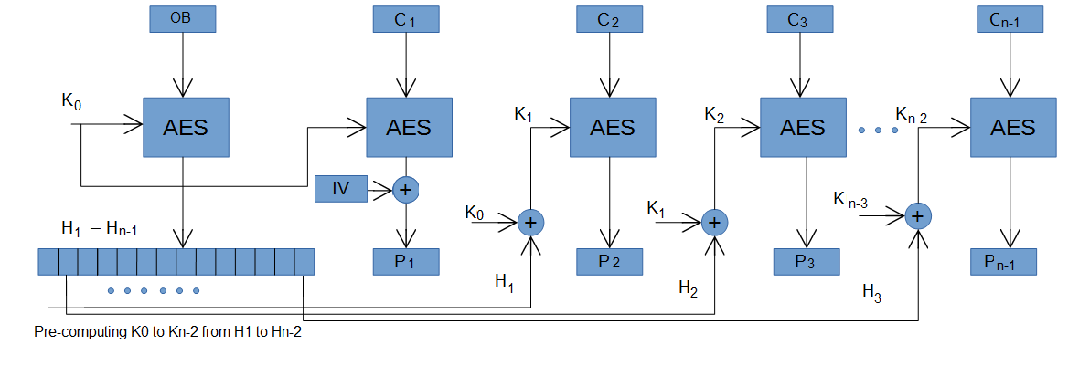
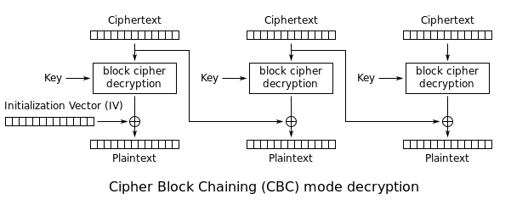
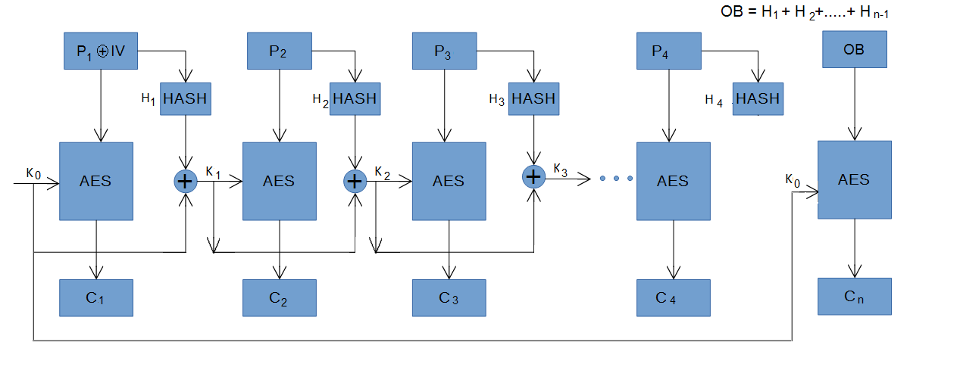
Advanced Encryption Standard – Hash Block Chaining
Suchanda Mukherjee, Mayur Agarkar
Guided by: Prof Yuriy Polyakov, Prof. Kurt Rohloff.
Department of Computer Science, New Jersey Institute of Technology, Newark, NJ
Introduction
INTRODUCTION (Cont.)
AES – HBC (Cont.)
BEAST Attack: (Browser Exploit Attack against SSL/TLS) BEAST is an attack that exploits the SSL implementation vulnerability of CBC mode of operation. Use of predictable IVs and unauthenticated decryption can allow one to guess plaintexts. This allows the recovery of cookies sent by a web browser over HTTPS, by enabling Man-in-the-middle attack and thus obtaining authentication tokens [4].
Oracle Padding Attack: The oracle is system which performs cryptographic function on behalf of user. In this attack, the attacker tries to calculate an intermediate stage before the plain text is XORed with previous cipher block. And after certain calculation attacker gets hold on the plain text [5]. In this attack, the attacker uses the padding oracle service to get plain text out of the cipher text. Suppose attacker has the cipher text. He/she then converts this cipher text into cipher blocks as per algorithm specifications e.g. C₀, C₁, C₂….. C_{n}.
Suppose attacker wants to now plaintext P₁ from cipher text C₁. Attacker
XORs last bit of previous cipher text C₀ with guess “g” and 0x01 i.e. last bit
of [C₀ ⊕ g ⊕ 0x01].Then if the guess is correct then the output of
decryption of C₁ i.e. C₁’ will have last bit same as the guess.
Then XOR of this last bit of [C₁’ ⊕ g ⊕ 0x01] will result in 0x01 which is valid
padding. Hence server will return result as valid padding which exposes last
bit of plain text which is equals to guessed text g. Similarly after few tries,
attacker gets hold of whole plain text.
In AES-HBC, a decent try was made to eliminate this problem as well. Since
during encryption and key generation, hash of a plaintext is used to XOR wit
next deciphered output. Hence if the oracle padding attack was made on
the previous plain text, the hash will not match with the existing hash.
Hence the decryption will fail and oracle will provide output with invalid
input.
Byte-Flipping Attack: When an attacker flips a bit of a cipher text, the corresponding plaintext will result in unintelligible message, but the next block of plaintext will see the bit flipped in the exact same position as of the cipher text. In CBC, the N-1th block is used to decrypt the N^{th} block. If the bits are flipped in N-1th block, then after XORing, the plain text will be changed. And it is very hard to detect the attack if the output of flipped word is meaningful word [6].
But in AES-HBC, this kind of attack has been successfully eliminated. If a
byte of N-1th cipher text is corrupted, then during decryption process, it will
result into some arbitrary garbage value instead of the bytes getting
flipped.^{[9]}
Performance Analysis [17]**: As compared with AES-CBC, where both the encryption and the decryption are parallel, AES-HBC offers similar performance with a better security.
AES-CBC runtime is proportional to the total number of blocks the algorithm is processing, since the output of the one block is fed to the next block. and the decryption is parallel. in AES-HBC the encryption is fully parallel, so the runtime reduces significantly. the decryption consists of decrypting the last block (overhead) first and then all other blocks can be processed in parallel. so the runtime is comparable to AES-CBC.
** On going research on performance and security comparison with existing algorithm. All results presented here are hypothetical until proven.
Advanced Encryption Standard: Rijndael algorithm was selected by the National Institute of Standards and Technology (NIST) for use as AES, which is developed by Vincent Rijmen and Joan Daemen. AES works in block ciphering mode which converts input in 16 characters blocks and does apply 10 round to encrypt the data. It is an advancement over its predecessor, DES. The main difference between AES and DES is that, AES does not use Feistel network. Also, it has 128-bit block size as input and works with various size of keys from 128 to 256-bit which are in increments of 64-bit, e.g. 128-bit, 192-bit & 256-bit [1,2].
In AES-CBC, each block of plain text is XORed with cipher text of previous plain text block before being encrypted. This makes each block to depend on previous cipher block.
Figure 1.1 [3] shows the encryption process on AES in CBC mode. Initialization Vector (IV) is used at each first block and is XORed with plain text block. This is done to add the uniqueness to message and avoid repetitions in cipher output.
The encryption process of AES-CBC can be mathematically represented as follows:
C_{i} = Enc _{k} (P_{i} ⊕ C_{i-1}), where,C₀ = IV
Where, K is key used for encryption. P_{i} is current plain text block. C_{i-1} is previous cipher text block.
Figure 1.2 [3] shows decryption process in AES-CBC mode. In this process cipher text of previous block is XORed with output of current step in order to get plain text. IV plays important role in the same, as incorrect IV can corrupt whole decryption process of first block. Even if first block fails, still rest of the block can be decrypted properly.
The decryption process can be mathematically represented as follows:
Pi = Dec k (Ci) ⊕ Pi-1 ⊕ Ci-1
where, P₀ ⊕ C₀ = IV
Where P_{i} is current plain text block, C_{i} is current cipher text block. P_{i-1} is previous plain text block.
Security Limitations of AES-CBC: There are few performance issues associated with AES-CBC. As AES-CBC uses the output of the previous working block as input to next, the encryption stage has to be processed sequentially, which is the main performance limitation of AES-CBC. Secondly, the message must be padded to make it a multiple of the cipher block size which leaves CBC with vulnerability of oracle padding attack.
Apart from the performance issues, CBC is known to be vulnerable to certain security attacks as well. The use of predictable IVs and unauthenticated decryption can allow one to guess plaintexts resulting in BEAST ATTACK [4]. Moreover, the padding oracle attack [5] is most commonly applied to the CBC mode of operation, where the "oracle" (usually a server) leaks data about whether the padding of an encrypted message is correct. This can allow attackers to decrypt (and sometimes encrypt) messages through the oracle using the oracle's key, without having any knowledge of the encryption key. AES-CBC is also susceptible to byte-flipping attack. In this attack, the attacker flips the byte of plain text. This leads to the corruption of cipher text. And if changed text is meaningful text, then it is very hard to detect such attack [6].
Performance Limitations of AES-CBC and past literature: Several approaches have been proposed to improve the performance of AES in the CBC mode and provide the partial support for parallelization at the encryption phase, including round stage pipelining [7], Structural binary CBC encryption mode [8], AES-Based Authenticated Encryption Modes in Parallel High-Performance Software [9], and others. But none of them provide full parallelization in encryption and decryption.
Applications of AES-CBC: CBC is one of the most used modes of operations for AES. It is used in SSL/TLS for communication security [10]. AES-CBC-HMAC is used in IPsec [11] to encrypt the data packets of an IP connection.
AES-CBC is also used for data security is SmartFusion2 and IGLOO2 systems which services asynchronous calls from Cortex A-3 Processor [12]. It accepts 128 bit or input text and supports key size of 128 or 256-bits. The AES-CBC block resides in controller of the system which encrypts and decrypts the data upon receipt. AES-CBC is further used in database applications for the database encryption and hiding sensitive data from hackers. It is used as main security algorithm for encrypting databases in financial [13] as well as healthcare [14] databases. Also, it is used in GPU accelerated applications on database to reduce the query result latency [15].
Basic Representation of AES-HBC:
K₀ = Initial key
IV = Initialization vector
P₁ – P_{n-1} = Plain text blocks
C₁ – C_{n} = Cipher text blocks (After encryption)
OB = Overhead block
P₁ = P₁ XOR IV
K₁ = K₀ (0bit – 8 bit) XOR H₁
K₂ = K1 (9bit – 16bit) XOR H₂
OB = H₁ + H₂ + … + H_{n-1}
Key size is 256 bits
Plaintext block size is 128 bits
Overhead block size is 128 bits
Hash size is 8 bits (light weight hashing)
The decryption is divided in two sequential steps:
Decryption of overhead block (OB);
Parallelizable decryption of cipher text blocks.
Figure 2.2 – Schematic of AES-HBC Decryption
The schematic of AES-HBC decryption is shown in Fig. 2.2.
The key facts about the AES-HBC decryption are summarized below:
When the cipher text is received by the other party, all the hashes of plaintext blocks are first extracted by decrypting the overhead block.
All keys are then computed using K0 and the hashes using the following expression: Ki = Ki-1 ⊕ Hi-1 = K0 ⊕ [H1, H2, H3, …. , Hi-1]
The appropriate cipher text block and key combination is next used to decrypt a specific block.
To completely decrypt the first block (recover P1), we XOR the decrypted block with IV.
It should be noted that steps 2 and 3 can be parallelized. The particular implementation depicted in Figs. 1 and 2 is based on 8-bit hashes. This implies that AES-HBC in this case can be used to encrypt 16 blocks at once (the size of OB is 128 bits). Other implementations are possible.
The hash function plays crucial and important role in AES-HBC. To keep the performance optimal, the hash function used here is very light weight. We can use the checksum algorithm to generate hash from the given input plain text. But we have to keep in mind that, hash function should not only be lightweight and fast but also should be secure enough that one cannot generate plain text back from hash.
The HBC cipher mode can also be applied to other symmetric-key algorithms, such as DES or 3-DES. The schematics would be the same as in Figs. 1 and 2 except for encryption steps (“AES” would be replaced with the appropriate algorithm).
Security Analysis**: AES-CBC is known to be vulnerable to certain security attacks. AES-CBC is vulnerable to following attacks:
BEAST attack [4]
Oracle Padding attack [5]
Byte-Flipping attack [6]
AES - HBC
The hash block chaining (HBC) mode is a modified CBC mode where both encryption and decryption are parallelizable [16].
Figure 2.1 – Schematic of AES-HBC Encryption
The schematic of AES-HBC encryption is shown in Fig. 2.1. The key facts about the AES-HBC encryption are summarized below:
The main distinctive feature of HBC compared to CBC is the use of hashing. At the encryption stage, the hash (a “light-weight” hash) is pre-computed for each block to remove the interdependency between two consecutive blocks and protect against certain known CBC attacks.
AES-HBC starts with an initialization vector (IV) which is XORed with the initial input block P1. The IV is randomly generated to protect against security attacks that rely on the repeatability of cipher text (BEAST ATTACK) for the given plaintext.
The resulting block is encrypted using key K0. The key for later blocks is computed using the expression: K_{i} = K_{i-1} ⊕ H_{i-1} In other words, the chaining in this case applies to the keys rather that the blocks of text.
The last block is an overhead block (OB) that is used to store the hashes of plaintext blocks. The OB is encrypted with the initial key K0. All hashes are needed by the other party to decrypt the cipher text.
CONCLUSION
This newly proposed algorithm not only introduces full parallelization in block chaining mode, but also provides better security as compared to AES-CBC and other widely used working modes of AES.
Also this algorithm uses existing working modules of AES irrespective of the programming language, hence it is easier to import one more module of HBC after developed to use it. Hence the cost of integrating with existing system is lot lesser than applying whole new algorithm for better security.
ANALYSIS**
REFERENCES
"AES Proposal: Rijndael", Daemen, Joan; Rijmen, Vincent (9/04/2003), National Institute of Standards and Technology. p. 1. Retrieved 21 February 2013.
"Announcing the ADVANCED ENCRYPTION STANDARD (AES)". Federal Information Processing Standards Publication 197. United States National Institute of Standards and Technology (NIST). November 26, 2001. Retrieved October 2, 2012.
"CBC encryption" by WhiteTimberwolf (SVG version) - PNG version. Licensed under Public domain via Wikimedia Commons –http://commons.wikimedia.org/wiki/File:CBC_encryption.svg#mediaviewer/File:CBC_encryption.svg"CBC decryption" by WhiteTimberwolf (SVG version) - PNG version. Licensed under Public domain via Wikimedia Commons –http://commons.wikimedia.org/wiki/File:CBC_decryption.svg#mediaviewer/File:CBC_decryption.svg
"Here Come The ⊕ Ninjas", Thai Duong Juliano Rizzo, 2011
"Practical Padding Oracle Attacks", Juliano Rizzo and Thai Duong, May 25th, 2010
"7019 - AES Bit-Flipping Attack". Hacking-Lab. Retrieved 4 November 2013.
“Parallelizability of CBC-MAC using Round Stage Pipelining Technique", M. Razvi Doomun and Z. Codabux-Rossan, Faculty of Engineering, University of Mauritius.
"Structural Binary CBC Encryption Mode", YI-SHIUNG YEH, TING-YU HUANG AND HAN-YU LIN, Department of Computer Science, National Chiao Tung University, Hsinchu, 300 Taiwan.
"AES-Based Authenticated Encryption Modes in Parallel High-Performance Software", Andrey Bogdanov and Martin M. Lauridsen and Elmar Tischhauser, Department of Mathematics, Technical University of Denmark, Denmark
“Cryptographic strength of ssl/tls servers: current and recent practices”, Homin K. Lee , Tal Malkin , Erich Nahum, Proceedings of the 7th ACM SIGCOMM conference on Internet measurement, October 24-26, 2007, San Diego, California, USA
"The AES-CBC Cipher Algorithm and Its Use with IPsec", S. Frankel, R. Glenn, NIST, S. Kelly, Airespace, September 2003.
"Using Advanced Encryption Standard System Services in the SmartFusion2 and IGLOO2 Devices", Microsemi Corporation, April 2014.
"High-Performance Encryption of Databases in Financial Services", Intel Corporation, 2013.
"High-Performance Encryption for Electronic Health Record Databases", Intel Corporation, 2012.
"GPU Accelerated AES-CBC for Database Applications", Scott Fazackerley, Steven M. McAvoy, Ramon Lawrence, SAC’12 March 25-29, 2012, Riva del Garda, Italy.
“Advanced Encryption Standard – Hash Block Chaining”, Mayur Agarkar, Masters Thesis, 2014-2015 (Ongoing)
“Performance analysis of Advanced Encryption Standard – Hash Block Chaining”, Suchanda Mukherjee, Masters Thesis, 2014-2015 (Ongoing)

